Slide 1
Working with images and scenes
CS 5010 Program Design Paradigms “Bootcamp”
Lesson 3.1
© Mitchell Wand, 2012-2014
This work is licensed under a Creative Commons Attribution-NonCommercial 4.0 International License.
TexPoint fonts used in EMF.
Read the TexPoint manual before you delete this box.: AAA

Slide 2
Module Outline
We’ll begin by reviewing Racket’s library for images and scenes.
Then we will learn about the Universe module, which we will use to create interactive animations.
We will learn how to do “iterative refinement”– that is, adding features to a program
We will learn more about how to design data.
We’ll do all this in the context of 3 versions of a simple system.

Slide 3
Module 03
Tools and Techniques
Object-Oriented Programming
Designing Data
Designing Functions
Designing Systems
Computing with Lists
Computing with Trees and Graphs
Designing with Invariants
Thinking about Efficiency
Interfaces and Classes
Inheritance
Objects with Mutable State
Efficiency, Part 2
Basic Principles

Slide 4
Lesson Introduction
Racket has a rich library for working with images and scenes.
We will use this library extensively in this course.
In this lesson, we will explore a few things from the library.
Note: this lesson is mostly review from Lesson 0.4

Slide 5
Learning Objectives
At the end of this lesson, the student should be able to:
Create simple images and scenes
Combine simple images into more complex images and scenes
Determine the properties of an image
Test images and their properties

Slide 6
Images are Scalar Data
In Racket, images are scalar data
Racket has:
Functions for creating images
Functions for combining images
Functions for finding properties of images
In general, we build complex images by starting with simple images and then combining them using functions.

Slide 7
Loading the image library
To load the image library, include the line
(require 2htdp/image)
in your program.

Slide 8
Functions for Creating Images (1)
bitmap : String -> Image
GIVEN: the name of a file containing an image in .png or .jpg format
RETURNS: the same image as a Racket value.

Slide 9
Functions for Creating Images (2)
rectangle :
Width Height Mode Color -> Image
GIVEN: a width and height (in pixels), a mode (either the string “solid” or the string “outline”), and a color
RETURNS: an image of that rectangle.
[See the Help Desk for information on the representation of colors in Racket].

Slide 10
Functions for Creating Images (3)
circle : Radius Mode Color -> Image
Like rectangle, but takes a radius instead of a width and height.
There are lots of other functions for creating shapes, like ellipse, triangle, star, etc.

Slide 11
Functions for Creating Images (4)
text
: String Fontsize Color -> Image
RETURNS: an image of the given text at the given font size and color.

Slide 12
Combining Images
The image library contains many functions for combining images into larger images.
These functions generally align the images on their centers. This is usually what you want. If you really want to align images on their edges, there are functions in the library to do that, too. See the help desk, as usual.
Let’s look at the two most commonly-used image combining-functions: beside and above. Here’s an example:

Slide 13
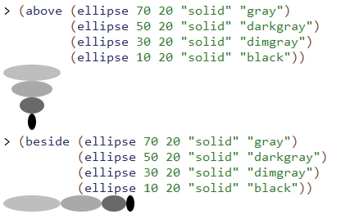
beside and above

Slide 14
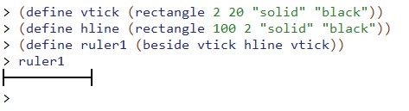
Slightly more complicated images

Slide 15
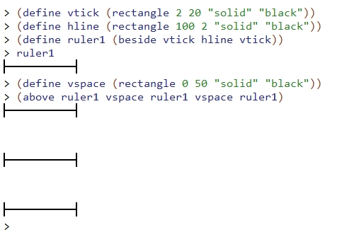
Slightly more complicated images
The rectangle has width 0, so it's invisible ☺

Slide 16
Scenes
A scene is an image that has a coordinate system.
In a scene, the origin (0,0) is in the top left corner. The x-coordinate increases as we move to the right. The y-coordinate increases as we move down. These are sometimes called “computer-graphics coordinates”
We use a scene when we need to combine images by placing them at specific locations.

Slide 17
Scene Coordinates
x
(0,0)
y

Slide 18
Creating Scenes
(empty-scene width height)
returns an empty scene with the given dimensions.
(place-image img x y s)
returns a scene just like s, except that image img is placed with its center at position (x,y) in s
resulting image is cropped to the dimensions of s.

Slide 19
scene+line
(scene+line s x1 y1 x2 y2 color)
returns a scene just like the original s, but with a line drawn from (x1,y1) to (x2,y2) in the given color.
the resulting scene is cropped to the dimensions of s.

Slide 20
Creating Scenes by Combining Simpler Functions
Create scenes with images in them by combining them with functions.
Start with an empty-scene, then paint images and lines on the scene by using place-image and scene+line.
This is all functional: painting an image on a scene doesn’t change the scene– it produces a new scene.

Slide 21

Video Demonstration
YouTube link

Slide 22
Measuring Images
Racket also provides functions for determining image properties. Here the most important ones:
image-width : Image -> NonNegInt
image-height : Image -> NonNegInt
image? : Any -> Boolean
In pixels

Slide 23
Bounding Box
The bounding box of an image is the smallest rectangle that completely encloses the image.
Its width will be the image-width of the image, and its height will be the image-height of the image.
It is easy to determine whether an arbitrary point is inside the bounding box– let’s look at an example.

Slide 24

Bounding Box Example
(x0,y0)
y = y0-h/2
(x,y) is inside the rectangle iff
(x0-w/2) ≤ x ≤ (x0 + w/2)
and (y0-h/2) ≤ y ≤ (y0+h/2)
h =
(image-height CAT-IMAGE)
w = (image-width CAT-IMAGE)
y = y0+h/2
x = x0-w/2
x = x0+w/2

Slide 25
Images and the Design Recipe: Examples
In your examples, describe the image in words.
Consider a function that takes an image and doubles it.
In your examples you might write:
(define red-circle1
(circle 20 "solid" "red"))
;; (double-image red-circle1)
;; = two red circles, side-by-side

Slide 26
Images and the Design Recipe: Tests (1)
First, construct the correct image. Do NOT use the function you are testing to construct the image.
In your tests, you might write
(define two-red-circles
(beside red-circle1 red-circle1))
Be sure to check it visually to see that it's correct
Alas, this step is not automatable.
Then you can use check-equal? on the resulting images:
(check-equal?
(double-image red-circle1)
two-red-circles)

Slide 27
Images and the Design Recipe: Tests (2)
check-equal? is fairly clever, but not perfect.
Which of the images below are visually equal?
See which of them check-equal? accepts as equal.
(define vspace1 (rectangle 0 50 "solid" "black"))
(define vspace2 (rectangle 0 50 "solid" "white"))
(define vspace3 (rectangle 0 50 "solid" "red"))
(define vspace4 (rectangle 0 50 "outline" "black"))
(define vspace5 (rectangle 0 50 "outline" "white"))

Slide 28
Summary
Images are ordinary scalar values
Create and combine them using functions
Scenes are a kind of image
create with empty-scene
build with place-image
2htdp/image has lots of functions for doing all this.
Go look at the help docs

Slide 29
Next Steps
If you have questions or comments about this lesson, post them on the discussion board.
Go on to the next lesson.

